Slide 1
AREC 570 Slides

Slide 2
Unit 6
Methods of Analysis

Slide 3
Reduced-form vs structural
Timmins & Schlenker

Slide 4
Overview
Like many topics in this course, I want to discuss them because I want to understand them better.
For years, I heard people use these terms without fully understanding what they meant - even after I asked people.
What is structural modeling?
What is reduced-form modeling?
When is each appropriate?

Slide 5
What is structural modeling?
“Put simply, we consider it to be any empirical model where one recovers the parameters of behavioral functions - e.g., demand and supply equations, indirect utility functions of individuals, or the cost structure of firms.”
Starts with theory
Identification generally comes from the model structure

Slide 6
Why structural?
Model complex feedbacks
- bioeconomic models with econ and ecological component
- Tiebout sorting

Slide 7
Example of structural
Jacobsen CAFE standards vs gas tax: CAFE impacts used car consumers
Supply: Firm decisions of what and how much to sell
Demand: Households decide what vehicle to purchase (new and used) and how much to drive; also when vehicles are scrapped
CAFE → Larger less fuel-efficient vehicles stay on the road longer; losses to producer and consumer surplus; Toyota & Honda (+) while Ford and GM (-); burden is regressive (impacts lower income consumers more)

Slide 8
Structural modeling
Advantages
Model parameters are well-defined in the context of the problem
Can accommodate dynamic feedbacks (human - biophysical systems)
Out of sample prediction
Monetizing welfare impacts (utility + estimates of the MU of income)
Disadvantages
Require many assumptions (some of which are testable)
Can quickly become intractable (emerging methods and increased computational power)

Slide 9
What is reduced-form modeling?
Evolved over time - initially defined as when system of equations were solved to eliminate endogenous variables (S&D system; Hedonic model)
Definition has become synonymous with program evaluation and treatment effects
Emphasis on identification - accurately measuring the effect of the treatment and isolating it from the effect of collinear variables
High-level parameters
Emphasis on understanding the details of the data - how it is collected; the institutional factors

Slide 10
Avoiding potential correlation with omitted vars
Panel FE to capture all time invariant additive factors
Quasi-experiments where treatment is arguably random (weather)
Regression discontinuity - those above/below a threshold experience treatment and are compared to those right below
Randomization of treatment assignment

Slide 11
Structural:
"causal arguments based on significance test and regression are almost necessarily circular. To derive a regression model we need an elaborate theory that specifies the variables in the system, their causal interconnections, the functional form of the relationships, and the statistical properties of the error terms - independence, exogeneity, etc." (Freedman 1991, p. 292)
Reduced-form:
“Take the model as a black box and test it against empirical reality. Does the model predict new phenomena? Does it predict the results of interventions? Are the predictions right?" (p. 293)
Are reliable predictions feasible with as few assumptions and structural feedback mechanisms as possible?

Slide 12
Example of reduced-form
Air pollution and crime: crime ~ air_pollution
Herrnstadt et al. (AEJ: Applied):
use geolocated crime (relative to highway), pollution, and wind direction (instrument)
Placebo tests - pretend highway moves around and check results
Burkhardt et al. (JEEM):
FE: county-by-year-by-month-by-day of the week

Slide 13
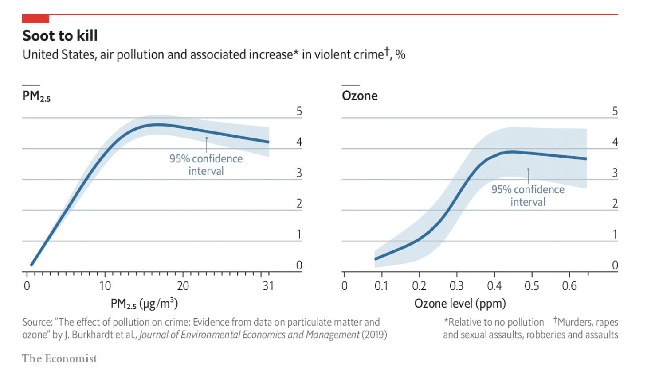

Slide 14
Reduced-form modeling
Advantages
Generally make fewer assumptions
Rely less on functional form
Transparent and source of variation is clear
Many more strategies and growing acceptance
Disadvantages
Identification is hard because the world is complex
Dynamic processes are tough

Slide 15
Summary
Structural models are based on theory and focus on decision parameters
Reduced form models focus on the empirical data and the source of variation to establish identification
Both are valid and have their strengths and weaknesses
We can learn from comparing results of the two approaches

Slide 16
Angrist - Mostly Harmless

Slide 17
Agenda
Talk through some of the material from the reading
Apply FAQs to your projects

Slide 18
Motivation
Backbone is still a good question with clear conceptual framework
Less emphasis on econometric methods and more on empirical research design
Where is the variation coming from and how close is it to the experimental ideal
FAQs:
relationship of interest?
Ideal experiment?
ID strategy?
Mode of inference?

Slide 19
Causal relationships
Most interesting because they allow the reconstruction of the counterfactual - what would have happened in the absence of the treatment
In reduced-form, the identified causal effect can help provide a prediction if the state of the world doesn’t change much
In structural, the identified causal effect can help predict how things may change even if the state of the world changes (maybe)

Slide 20
Ideal experiment
What is the ideal experiment to quantify the relationship of interest?
How would you assign the treatment/policy?
If you cannot design an ideal experiment, you probably cannot identify it using observable data
Fundamentally unidentified questions (FUQ) – book example?
Notes:
Fundamentally unidentified questions (FUQ) - delaying school start age; testing at different points means some have more schooling; testing at same time but different ages mean some are more mature

Slide 21
ID strategy
“the manner in which a researcher uses observational data (i.e., data not generated by a randomized trial) to approximate a real experiment”
Given the data you have, how are you approximating your ideal experiment
What are your strategies strengths and weaknesses?

Slide 22
Mode of statistical inference
Estimator - OLS, GLM, ML methods?
SE handling: robust, clustering
This is where econometrics courses spend most of their time

Slide 23
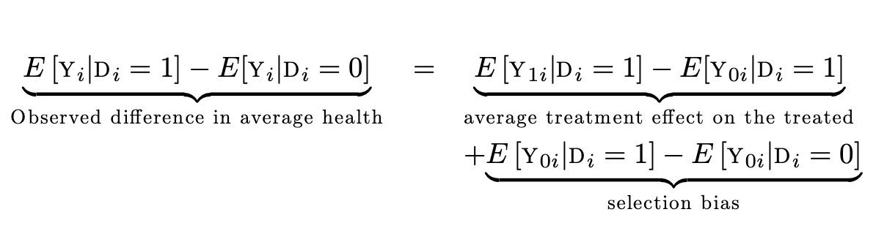
Selection and the experimental ideal
Selection as a threat to the experimental ideal of random assignment
Do hospitals make people more healthy? Less healthy people are more likely to go to the hospital
Outcome of the treated had they not been (unobserved)
Treatment observed
No treatment observed

Slide 24
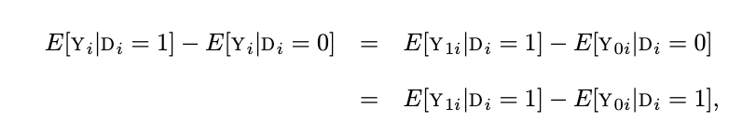
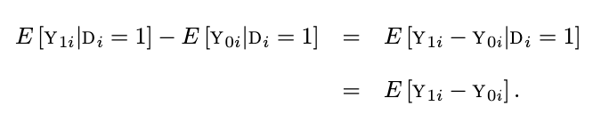
Random assignment
Creates independence between Y (outcome) and D (treatment) making the difference between treated and untreated equivalent to the ATT
*Because of independence

Slide 25
Selection in regression
Selection amounts to correlation between the treatment effect and the error, which violates E[e’x]=0
Hospital Q: those treated were less healthy
Covariates play 2 roles:
Random assignment conditional on something. STAR study random within school but not across
Help make the estimates more precise by reducing residual variation. This shouldn’t substantially change the coef of interest, but may reduce SE.

Slide 26
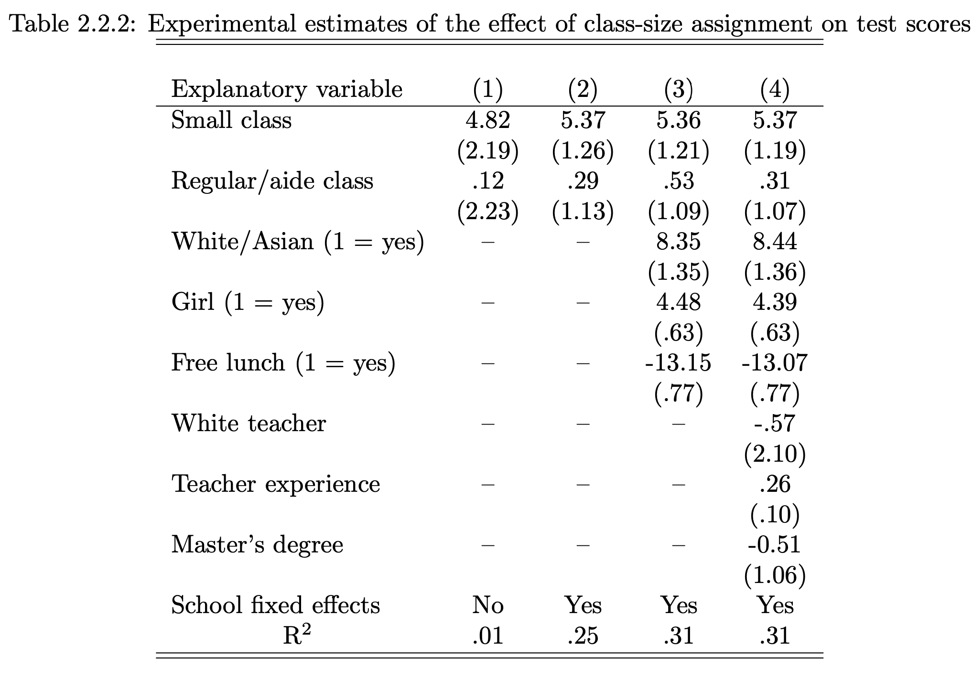
What does this table tell you?
How did you read it?

Slide 27
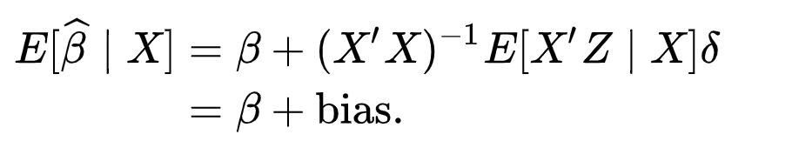
Omitted variables bias
Omitted variables bias occurs when a covariate (Z) is omitted from the reg when the true but unknown model includes it (Z partially explains Y - along with X)
Note that if X and Z are uncorrelated, the bias falls out

Slide 28
Apply the FAQs to your question
FAQs:
relationship of interest?
Ideal experiment?
ID strategy?
Mode of inference?

Slide 29
State of Applied Metrics
Athey & Imbens
Athey, S., & Imbens, G. W. (2017). The state of applied econometrics: Causality and policy evaluation. Journal of Economic Perspectives, 31(2), 3-32.

Slide 30
Overview
Causal inference, identification, methods (SCM, RDD, external validity)
Supplementary analyses
ML methods for causal inference
Focus on reduced-form or design-based methods

Slide 31
Causal inference
Randomization is the gold standard. Why?
Difference in differences
Synthetic control methods (SCM)
Regression discontinuity designs (RDD)
Matching methods

Slide 32
Estimator vs Estimand vs Estimate
Estimator is the method or model used - how the thing is estimated
Estimand is the target of inference - the parameter you care about
Estimate is the best guess of the estimand given the data you have

Slide 33

Regression Discontinuity Design
Study the population near some threshold, c, where a forcing variable, X (e.g., age), dictates treatment, W
Sharp regression discontinuity - W is binary 0,1 makes denominator 1
Fuzzy regression discontinuity
Local linear regression with more weight near the threshold (loess - geom_smooth()); how to choose bandwidth

Slide 34
The effect of summer school
Chicago public schools had a rule that 3rd graders that scored less than 2.75 on a standardized test had to take summer school. The question is what impact did the summer school have on subsequent exam scores?
Forcing variable?
Threshold?
Outcome?
Why is RDD appropriate here?

Slide 35
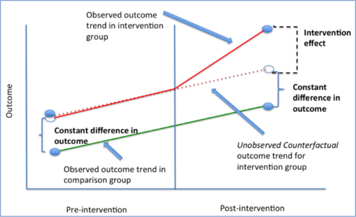
Difference in differences
Using an untreated group as the control to generate unobserved counterfactual
Pre-treatment trends should be parallel
Two way fixed effects
Lots of recent discussion about TWFE
Card (1990) Mariel boatlift (treatment to Miami) on low-skilled wages (control=Atlanta, Houston, Petersburg)
https://taylorjwright.github.io/did-reading-group/

Slide 36
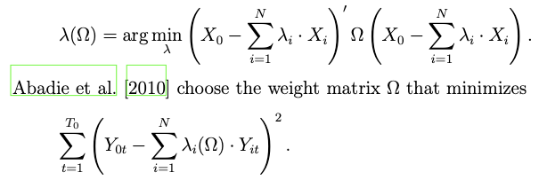
Synthetic Control Method
Relative of DiD, but uses the “control” group in a different way to generate the unobserved counterfactual
Rather than the average of the controls (DiD), you estimate weights during the pre-treatment period that minimize the deviation of the to-be-treated unit and the synthetic unit

Slide 37
Supplementary analyses
Developed to enhance the credibility of the primary analysis - probe the identification strategy
Not focused on goodness of fit or choose against competing models
Placebo tests
Present results from alternative specifications (sets of controls, FE, functional forms)

Slide 38
Placebo tests
Replicate the primary analysis in a context where the outcome is known to not be affected by the treatment. Strong priors that beta=0.
Lottery example: impact of lottery winnings on earnings? Panel data so pretend people won lottery before they actually did.
Covariates in RDD. By design, they should be uncorrelated with treatment, so test by regressing them on treatment.
These strategies build confidence that your identification strategy is credible
Notes:
Lottery example: Can we think of a placebo test to probe identification of the treatment (winning the lottery)? The control group is people that won smaller prizes. This helps make the comparison between treatment and control more believable. A placebo might be regressing pre-treatment earnings on winning. We expect no effect.
In RDD, the covariates should be uncorrelated with the treatment conditional on the forcing variable (the thing that along with the threshold determines treatment). Test this conditional independence by using some presumed uncorrelated covariate as the outcome of interest in the RDD.

Slide 39
Robustness and Sensitivity
Pretest bias – frequentist’s paradigm suggests specifying a single model and estimating it once.
Robustness estimations shouldn’t be viewed as additional analyses requiring multiple testing
Sample splitting method? Split sample by covariate i, fit models, report stdev across all splits

Slide 40
Machine learning and econometrics
Unsupervised: finding patterns in data, reducing dimensionality (clustering)
Clustering images, test analysis
Use as intermediate step to reduce dimensionality in subsequent analyses
Supervised:
Shares characteristics with regression but with a focus on prediction (rather than predicting potential outcomes)
Focus on out-of-sample fit

Slide 41
Important distinctions
Conventional econometrics seeks unbiasedness without much compromise; ML methods make a bias-variance tradeoff to improve prediction accuracy
Data-driven model selection (tuning parameters)
Emphasis on out-of-sample fit, which avoids over-fitting

Slide 42

Penalized regression - LASSO
Least Absolute Shrinkage and Selection Operator
Add a cost to the objective function to be minimized that prioritizes parsimony
Tune lambda using cross-validation (divide up the data into samples)
Can estimate models with K>N

Slide 43
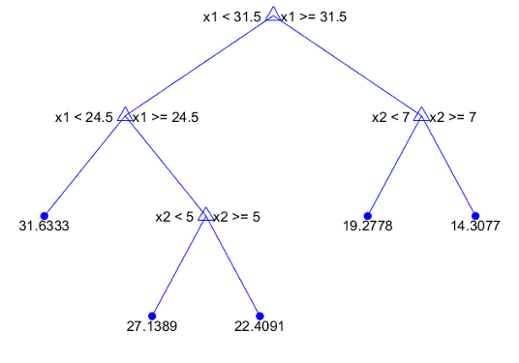
Regression trees and random forests
Simple tree: calc sum of squared residuals, can you reduce SSR by splitting the dataset based on a covariate? If so, do it (growing the tree) and repeat process
Random forest grows many trees using (potentially) different sets of covariates then averages across models
Finds patterns amongst the trees
Conventional RF tend to be bias-dominated

Slide 44
ML and causal inference
LASSO can eliminate relevant variables creating OVB. Solution: use LASSO to find subset of vars correlated with outcome, then same to find vars correlated with treatment. Then OLS based on the union of the two sets.
LASSO for IV
Deep learning and neural nets? Black box so not well-suited for causal inference
Deep IV: the first stage in IV is concerned with prediction, so first-stage estimation is a good candidate for prediction-focused methods

Slide 45
Summary
Causal inference methods focus on the source of variation: DiD, SCM, RDD
Supplementary analyses build credibility of your ID strategy
ML methods are rapidly evolving and gaining acceptance in econ

Slide 46
Qualitative Methods

Slide 47
Overview
“the profession has some tendencies to associate ‘good’ research qualities (representativeness, rigor, objectivity, explanation) with quantitative data and methods, and corresponding ‘bad’ ones (un-representativeness, informality, subjectivity, description) with the qualitative.”
Not generally thought of as part of contemporary economists toolkit
Quant and Qual methods have strengths and weaknesses
Well-done qualitative work can contribute to the body of knowledge – our understanding of some economic process

Slide 48
What are qualitative methods?
*Great example of roadmap with information
Not simply words (vs numbers)
Key distinction: open-ended vs closed approach to gathering data
In-depth interviews: spectrum of structure, recorded and transcribed
Focus groups: semi-structured group discussions
Case studies and site visits: in-depth analysis of a relatively small number of cases
Fieldwork or ethnography: extended observation of community or group
Life histories: in-depth interview about important events over one’s lifetime
Generally looking for patterns; emerging computational tools to augment an individual’s productivity

Slide 49
Distinguishing qual and quant methods
Open-ended data collection - has a research question but does not constrain the dimensions of the data (pre-specified instrument)
Multiple choice questions about home buying vs “tell me how you came to buy this house”
Qual methods do not presuppose the factors or relationships between phenomenon
Both can be done well and poorly - we just tend to know how to deal with issues in quantitative analysis

Slide 50
Distinguishing qual and quant methods
The lack of structure in qualitative data can make analysis more complex – one needs to be able to summarize and find themes in responses

Slide 51
Contrasting methods
Qualitative | Quantitative
Enter investigation not knowing the parameters of the problem potentially more and richer data but it varies across individuals (less structure) good candidate when: little is known about topic when extensive quant has been done and questions remain when back and forth is needed to elicit information inherent complexities in the problem when subject views is the focus Smaller sample sizes | Structure comes from theory but makes strong assumptions about parameters of the problem. Structure facilitates analysis of sample and maybe draw inference about population or subpopulations

Slide 52
Types of qual methods
In-depth interviews: structured, semi-structured, unstructured (how many questions are predetermined). Detailed notes or transcription so info can be analyzed after.
Focus groups: semi-structured to draw out opinions of the group
Case studies/site visits: select small number of cases to dig into deeply, pulling info from a variety of sources: interviews, media, records. A Smith and the pin factory

Slide 53
Types of qual methods
Fieldwork/ethnography: embedding in a community to explore longer-term relationships/culture.
Life histories: focus on large events in individuals’ lives
Mixed methods:
- qual first with open ended questions to design quantitative component (common in non-market valuation)
- structured (quant) survey first; then follow up with in-depth interviews
- conduct qual and quant simultaneously and use information from one to help interpret the other

Slide 54
Bewley 1999 and Blinder 1998
Interviewed hundreds of business people asking why wages were not lowered or prices were not changed when macro conditions changed (sticky wages)
Competing theories for why without quantitative data to disentangle
Found that it was fairness and employee morale. Led to further discussions
Many other examples of qualitative work
Contingent valuation method in environmental work - seeking to understand why WTP is overstated

Slide 55
Concerns
that “it leaves too much scope for perspectives of the researcher(s) to affect research results;
that the quality of self-reported information should be doubted;
that its very richness undercuts its usefulness for building and testing abstract conceptualizations of phenomena of interest.

Slide 56
Mitigating perspectives of researcher
(a) fully explaining and documenting procedures and protocols, so that the methodology of the study is transparent and potentially replicable;
(b) explaining in the write-up any unique aspects of the researcher or the research design that might make the results different from what another study using a similar method would find;
(c) conducting research in teams, often interdisciplinary, to benefit from exchanges among researchers with different perspectives;
(d) making systematic use of opportunities to cross-check findings via other information sources (i.e. triangulate), so that those which do cross-check can be understood as having better empirical support than those that do not

Slide 57
Skeptical of people’s responses
People may have incentive to misrepresent information.
Establishing rapport and other techniques to allay concerns
People may not know or be able to articulate what researcher wants to know
Ensure that the subjects are reliable “key informants”; that they understand the reasons behind the choices they are making
Notes:
Friedman’s analogy of the billiard player who has no formal knowledge of physics but plays as if he does

Slide 58
Fine for description but not explanation
Preferred methods in econ build deductive arguments (theory) and test hypotheses
Qualitative work uses an “informal Bayesian logic” - revise ideas as they encounter new information

Slide 59
Comment on ethics
Starr questions the ethics of not talking to research subjects
Is it ethical for us (the trained economists) to develop models and hypotheses of how the world works, making assumptions about how people make decisions?

Slide 60
Exercise
How would you design qualitative research method to answer your research question?

Slide 61
Gibson - Estimating the Right Thing

Slide 62
Motivation
Credibility revolution has focused effort on questions for which we have good identification strategies. It isn’t clear these are the most pressing questions in the field.
We should allocate research effort to areas with the highest marginal benefit
Maybe measurement error and misinterpreting data
New data may be more precise (gps) but infrequent survey may be less reliable
Data on registrants rather than occupants

Slide 63
Criticisms of Credibility Revolution
that attention focuses on less ambitious sets of questions such as treatment effects of a particular policy in place
that randomized designs make no fewer assumptions than structural econometrics, but do so implicitly not explicitly
that randomistas focus on whether treatments worked, but not why they worked
that actual balance in any single RCT is confused with balance in expectation over many (hypothetical) trials
that cumulative scientific progress is undermined by minimizing the role of prior knowledge
Notes:
that attention focuses on less ambitious sets of questions such as treatment effects of a particular policy in place, but not effects of new policies or of old policies in new environments, creating a selection bias in what gets evaluated;
that randomized designs make no fewer assumptions than structural econometrics, but do so implicitly not explicitly, and with assumptions about determinants of treatment, such as “no defiers” (subjects doing the opposite of what they are assigned to do) rather than about how treatment affects outcomes
that randomistas focus on whether treatments worked, but not why they worked; (d)
that actual balance in any single RCT is confused with balance in expectation over many (hypothetical) trials; and, (e)
that cumulative scientific progress is undermined by minimizing the role of prior knowledge

Slide 64
Unnecessarily restricting data
Estimate limited dependent var model when continuous var is available
Ignoring information and making unnecessary assumptions
Thresholds (e.g., poverty) can be estimated ex-post
Misclassification is more consequential in limited dependent var models

Slide 65
Quantity vs quality
We often look at quantity response but quality is often imbedded
These can be conflated in demand systems based on budget shares
Model quantity and quality separately

Slide 66
Spatial spillovers
If the process is inherently spatial, we should model it as such
Advocates generalizing to spatial model and treating non-spatial as a restricted case
Air pollution and CRP

Slide 67
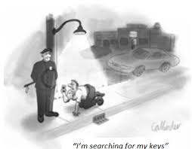
Is research design the weakest link in our research process chain? Where should we direct efforts?
Are we applying economic principles to our research process?

Slide 68
Kim - False Positives

Slide 69
Motivation
Growing concern that non-trivial amount of evidence is the outcome of false positives
Level of significance is often chosen arbitrarily p < .05
Power is often ignored (or the probability of Type II error)

Slide 70
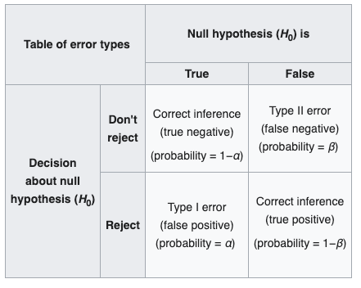
Type I and II error
type I error is the rejection of a true null hypothesis (also known as a "false positive" finding or conclusion; example: "an innocent person is convicted")
type II error is the non-rejection of a false null hypothesis (also known as a "false negative" finding or conclusion; example: "a guilty person is not convicted")

Slide 71
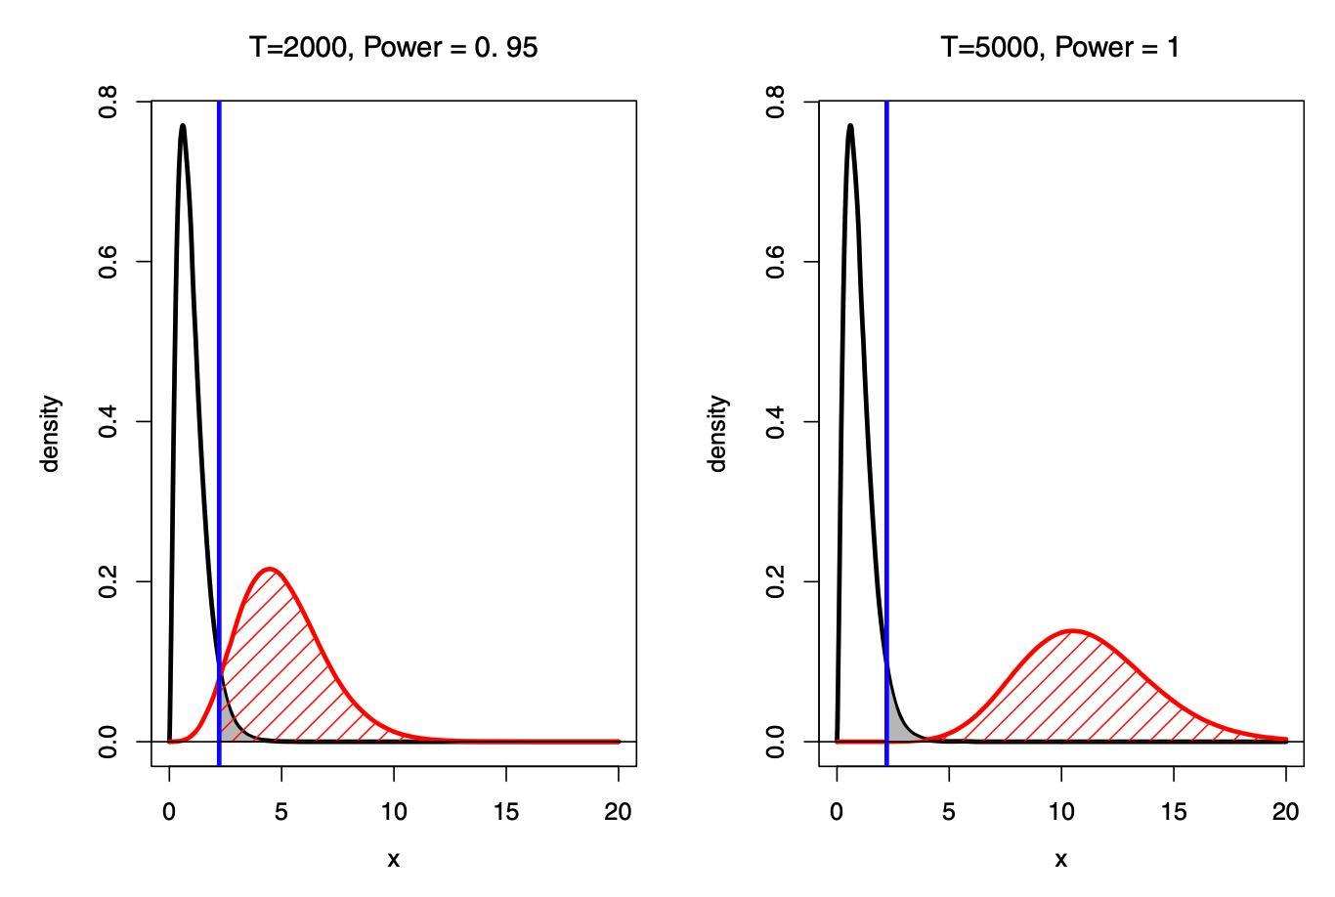
Sample size affects interpretation of evidence
Black is the F dist under H_0
Gray shaded area is alpha (prob of type 1 error)
Red is the F dist under H_1
Prob of type 2 error is beta (power=1-beta; unshaded area under red curve)
Panels differ by sample size
We often focus only on alpha

Slide 72
Sample size affects interpretation of evidence
When sample size is large, the prob of a type 2 error is small and type 1 error is higher in comparison
Pr(F>3|H_0)=0.01
Pr(F<3|H_1)=0.0001
Ftest outcome is incompatible with H_0 with an odd of 0.01
Ftest outcome is incompatible with H_1 with an odd of 0.0001

Slide 73
Pval can be misleading
“The p-value measures how unlikely the observed statistic is if H0 were true. While the p-value can indicate how incompatible the data is with H0, it does not measure the probability that H0 is true”

Slide 74
More balanced look
P-value if Pr(F>3|H0)=0.01
Less than 0.05 so significant!
beta is Pr(F<3|H1)=0.0001
Incompatible with H0 prob=0.01
Incompatible with H1 prob=0.0001
We should be concerned with the relative probabilities of the competing hypotheses

Slide 75

Zero Probability Paradox and Large-Sample Problem
H0 of beta=0 assumes exactly 0, which has prob of 0 even theoretically
One consequences is that large enough samples increase the probability of false positive (incorrectly reject the null hypothesis)
F stat is an increasing function of sample size
Increased sample size increases chance of rejecting the null hypothesis

Slide 76
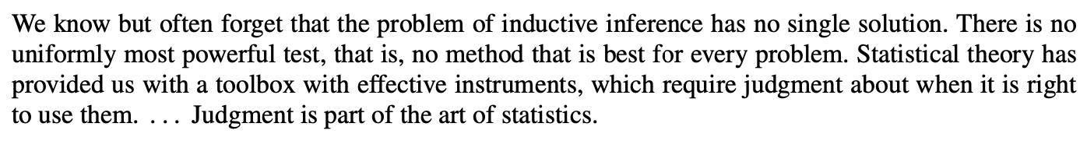
A Statistical Toolbox
Bayes factor
Prob H0 is true given the data
Adaptive level of significance - decreasing function of sample size
Optimal level of significance
Equal prob test and sample size selection
Cautionary analyses
Equivalence testing

Slide 77
Bayes factor
Bayes factor compares the compatibility of the data with H0 and H1
The intuition is based on the slide with the two plots above

Slide 78
Prob H0 is true given the data
P-val is Pr(D|H0) - prob of the sample/estimate given the null hypothesis is true
More informative to evaluate Pr(H0|D) and lays out formula on page 7
Desirable property: converges to 1 when H0 is true and 0 when H1 is true

Slide 79
Adaptive level of significance
Because F stat is increasing in obs, make level of significance depend on n rather than choose fixed alpha
Makes level of significance decreasing function of sample size
Formula on page 8

Slide 80

Optimal significance
Expected loss
P=prior probability that H0 is true
k=L2/L1 where Li is the loss associated with type i error
What are the consequences of the type 1 and 2 error: better to convict an innocent person or let a criminal free

Slide 81
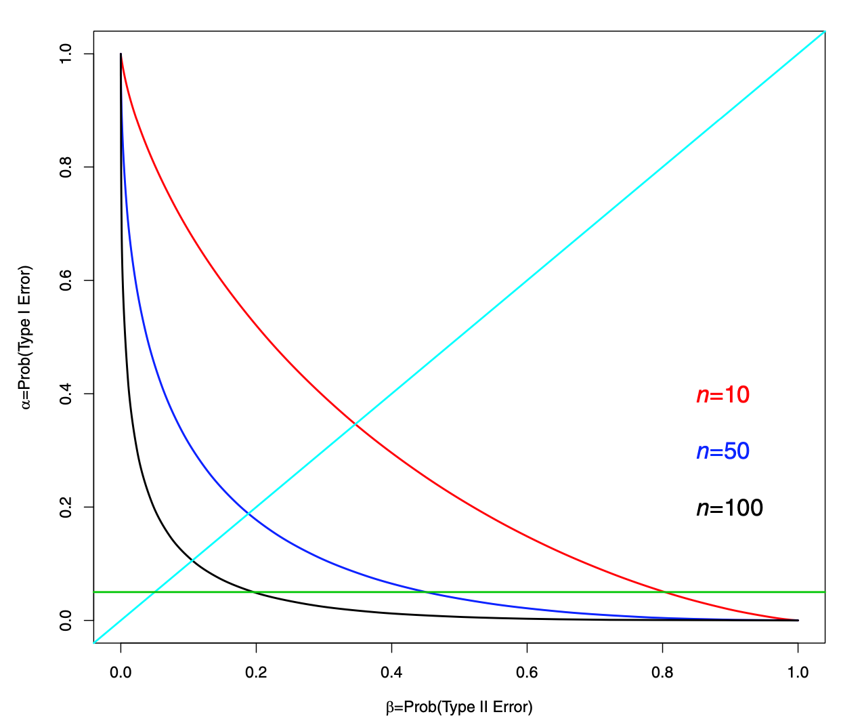
Line of enlighten judgement

Slide 82
Equal probability test
Balance prob of type 1 and 2 error
Choose alpha such that
This can also guide sample selection, T

Slide 83

Equivalence testing
Returning to the point-null problem, Kim advocates for constructing a null hypothesis over an interval
Upper and lower bounds should be determined based on economic reasoning
Your statistical test corresponds directly with your theory

Slide 84
Cautionary Analyses for Large Sample Bias
Kaplan et al. (2014) note that, with a large data set, ‘investigators will surely have less intimate knowledge about the texture and often the quality of the many elements in their datasets’
As Kaplan et al. (2014) point out, when the sample size is small, the estimation bias may not show up strongly; but as the sample size grows, the estimation bias can be magnified.
Understand the potential for large sample bias and the probability of false positive

Slide 85
Reporting Methods of Analysis

Slide 86
Overview
The goal is to document how you generate the evidence to support your argument - reproducible in principle
Clear organization of analysis steps

Slide 87
Organization
Data → Empirics: works for empirical papers that don’t have theoretical model; preview the model, detail the construction of your dataset, then specify model(s)
Theory → Empirics → Data: works for papers where you derive model directly from theory (structural)

Slide 88
Contents
The model and any relation to predecessors
Included controls and why, FE
Introduce or recap identification strategy
Issues with inference (se)

Slide 89
Recipe
A recipe is a good metaphor for this section.
You are explaining the steps to arrive at your results
Reproducible code can serve as a technical supplement
I would like you to emphasize this section in your proposals

Slide 90
Summary: Methods of Analysis
Structural vs reduced form
Identification (mostly in reduced form) trying to recover the experimental ideal
Experimental methods
Qualitative methods
Understand the data and make sure you are estimating the right thing
Think beyond the p-value; employ a broader statistical toolbox

